Slide 1
Game Design

Slide 2
Hello world!
We are the Game Design tech team
Mitchell Loveall, Dan Carlozzi, Kevin Smearsoll, Marshall Williams

Slide 3
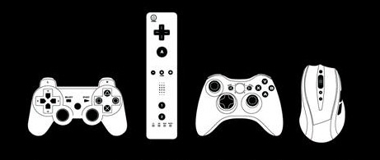
Tools of Play
The components required to play games

Slide 4
Rule Development
Games can be defined by rules

Slide 5
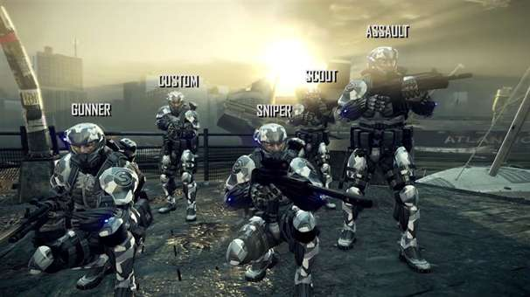
Single or Multiplayer
Some people love to play with others, while some enjoy playing alone

Slide 6
Storylines and Plot
Many of the best games make use of classic storytelling techniques

Slide 7
Luck and Strategy
A game’s tools and rules will result in its requiring skill, strategy, luck, or a combination thereof, and are classified accordingly

Slide 8
1.
What Is A Game?
Several very smart people have tried to define game

Slide 9
Definition of Game
“A game is the voluntary attempt to overcome unnecessary obstacles.”
- Bernard Suits, The Grasshopper (1978)
Attempt to create a definition that encompasses all kinds of games

Slide 10
Definition of Game
“A game is a series of interesting decisions.”
– Sid Meier
States very little about what the word game means
But states a lot about his personal beliefs about what makes a good game

Slide 11
Definition of Game
“A game is a closed, formal system that engages players in a structured conflict and resolves its uncertainty in an unequal outcome.”
– Tracy Fullerton, Game Design Workshop (2008)
Not only a definition of game, but also a list of elements that designers can modify
Formal elements, Dynamic systems, Conflict structure, Uncertainty, and Unequal outcome

Slide 12
Definition of Game
“A game is a problem-solving activity, approached with a playful attitude.”
– Jesse Schell, The Art of Game Design (2008)
Similar to Suits, it is the playful attitude of the player that defines a game

Slide 13
Game design is the art of applying design and aesthetics to create a game to facilitate interaction between players for playful, healthful, educational, or simulation purposes.

Slide 14
2.
How to Design A Game?
Analysis frameworks are involved in this process

Slide 15
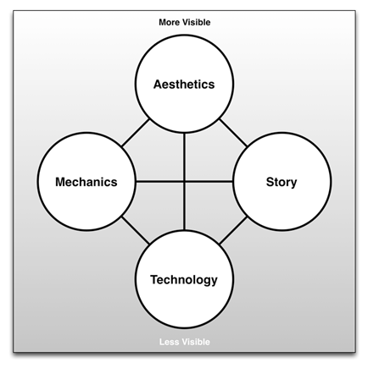
The Elemental Tetrad
From The Art of Game Design: A Book of Lenses by Jesse Schell

Slide 16
Mechanics
Rules for interaction between the player and the game
Differentiate games from other non-interactive media
Contain:
Rules
Objectives
Other Formal elements

Slide 17
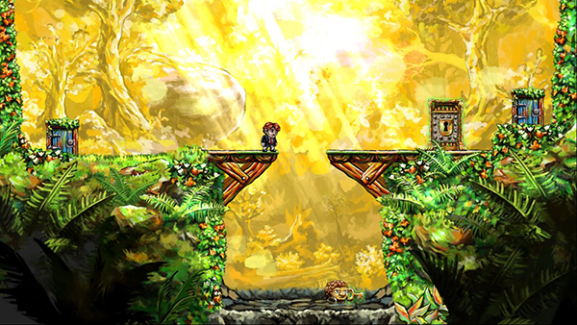
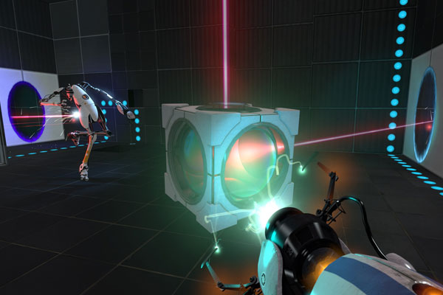
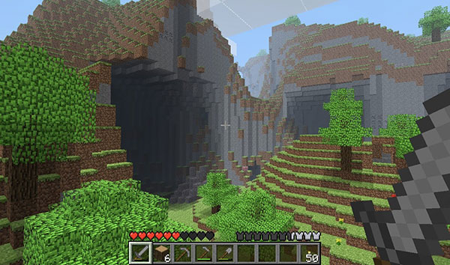
Games That Have Interesting Mechanics
Braid (2008)
Portal 2 (2011)
Minecraft (2009)

Slide 18
Aesthetics
Describe how the game is perceived by the five senses:
Vision
Sound
Smell
Taste
Touch
Many different aspects of aesthetics:
Soundtrack
3D graphics and animation
Packaging and cover art

Slide 19
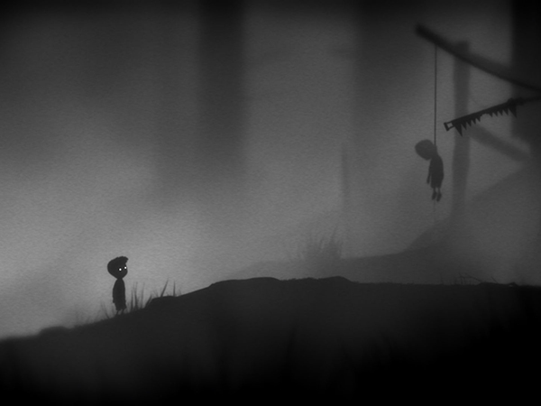
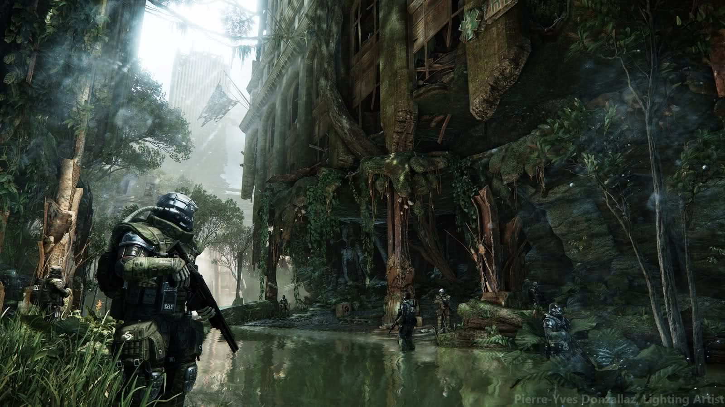
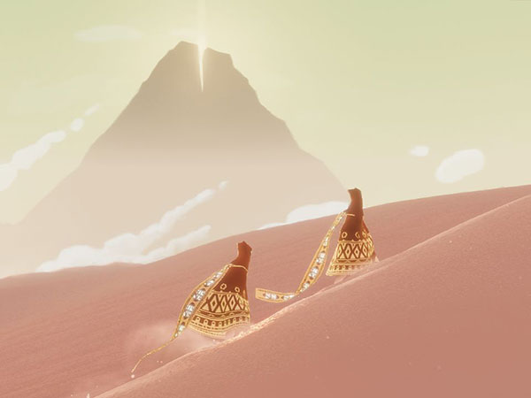
Games That Have Stunning Aesthetics
Limbo (2010)
GPU Crisis 3 (2013)
Journey (2012)

Slide 20
Technology
The underlying technology that makes the game work:
Digital technologies
Computer and console hardware
Software and programming
Rendering software and pipelines
Paper technologies:
Dice and other randomizers
Statistics tables

Slide 21
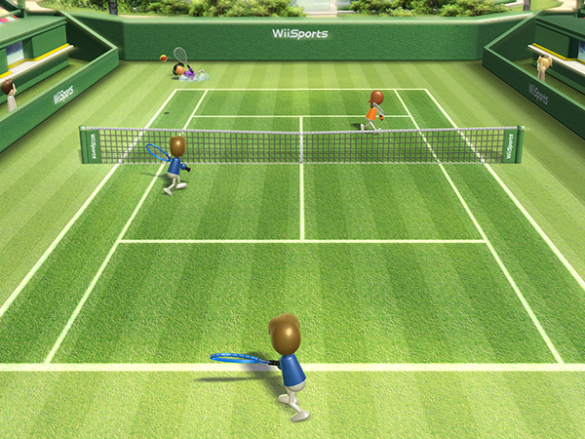
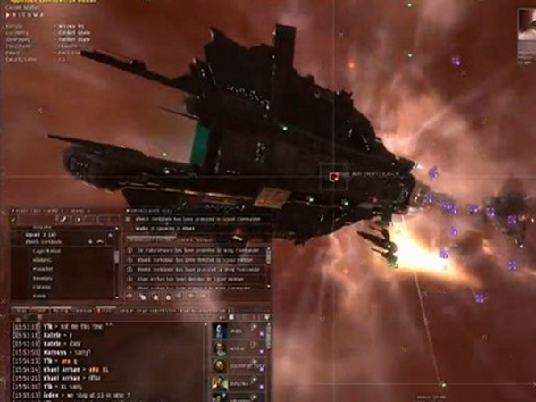
Games That Use Interesting Technology
Wii Sports (2006)
Nintendogs (2005)
EVE Online (2003)

Slide 22
Story
Make the rules and resources more understandable
Give players greater emotional investment in the game
Elements:
Premise
Character
Story

Slide 23
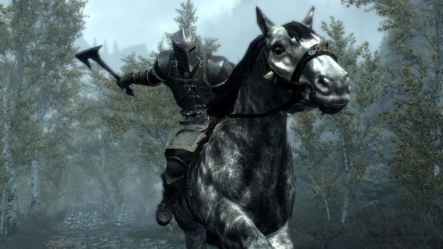
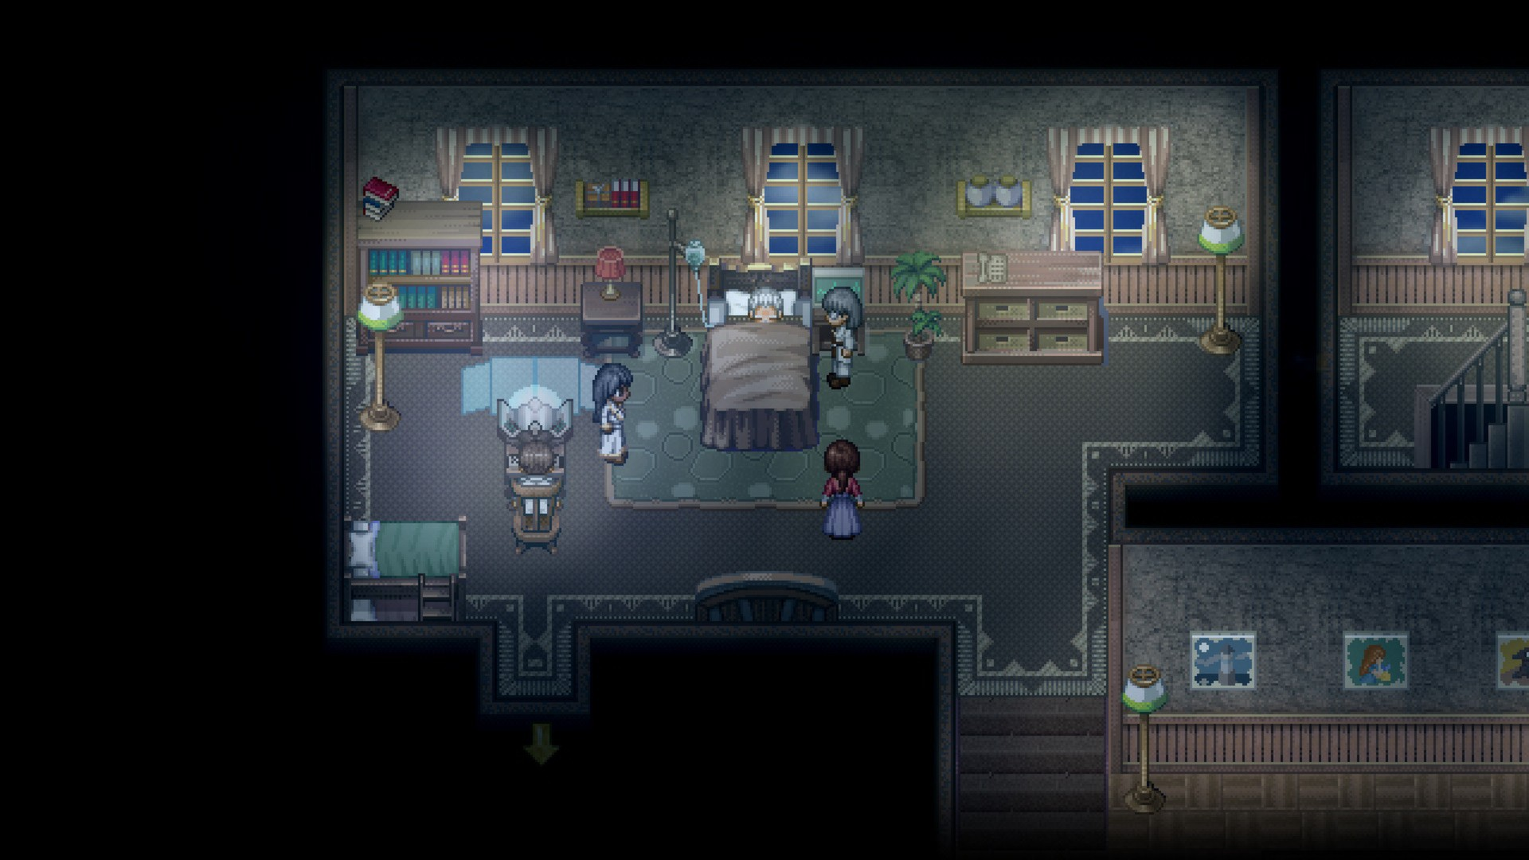
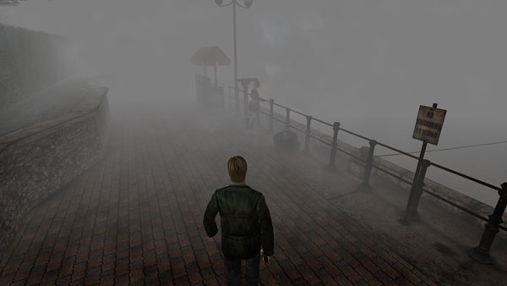
Games That Focus On Stories
Elder Scrolls V: Skyrim (2011)
To the Moon (2011)
Silent Hill 2 (2001)

Slide 24
3.
How To Design A Good Game?
Iterative design methodology is the key

Slide 25
The Process of Game Development
Game Design
Proto
typing
Develop ment

Slide 26
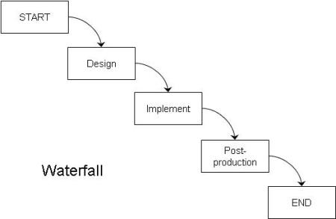
Waterfall Method
Historically, the first design methodology was known as the waterfall method

Slide 27
Waterfall Method
Waterfall is so named because, like water in a waterfall, you can only move in one direction
If you’re busy making the final art for the game and it occurs to you that one of the rules needs to change, too bad — the methodology does not include a way to go back to the design step once you are done

Slide 28
Iterative Design
A design methodology based on a cyclic process of prototyping, testing, analyzing, and refining a product

Slide 29
“Game design is 1% inspiration and 99% iteration”
– Chris Swain

Slide 30
The Process of Game Development
Game Design
The iterative process of crafting interactive experiences for players.
Prototyping
The creation of various paper and digital tests for your game design.
Development
The programming and implementation of a digital game that has been refined through prototyping.

Slide 31
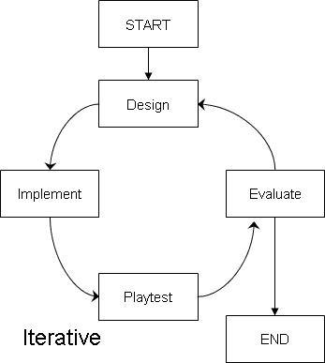
Iterative Approach

Slide 32
Iterative Approach
As with waterfall, you first design the game, then implement it, and then make sure it works
But after this you add an extra step of evaluating the game
Play it, decide what is good and what needs to change
And then, make a decision: are you done, or should you go back to the design step and make some changes?
If you decide the game is good enough, then that is that
But if you identify some changes, you now go back to the design step, find ways to address the identified problems, implement those changes, and then evaluate again
Continue doing this until the game is ready.

Slide 33
Iterative Approach
In general, the more times you iterate, the better your final game will be
The iterative process of design is the key to good game design
Game design and development both take lots of practice!

Slide 34
Game Engines
Where Videogames are created

Slide 35
Background Info
Game engines are softwares that are used to create and develop video games.
Important features include: Physics System, Scripting, Rendering, Sound, Networking, AI, etc.
Many engines are able to format files from 3rd party applications for certain tasks.
There are many game engines out right now, but we will be focusing on Unity, and The Unreal Engine.

Slide 36
http://en.wikipedia.org/wiki/Unity_(game_engine)#/media/File:Unity_3D_logo.png

Slide 37
Unity
Released in June 2005
Unity 1.0-4.0 (2005-2012)
Free and Pro version
Unity 5 (2015) made the entire engine free to the public
Script is written in C#, Boo, and JavaScript

Slide 38
Notable platforms and games
Platforms
Windows, OS X, and Linux
PS3/4/Vita, Xbox 360/One, and Wii U
Games
I Am Bread
Hearthstone: Heroes of Warcraft
Pillars of Eternity

Slide 39
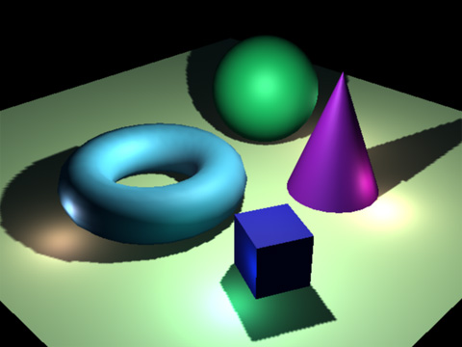
Rendering Paths
Unity supports four different rendering paths
Deferred Shading
Forward Rendering
Legacy Deferred
Legacy Vertex Lit
Can be chosen by the user or it will choose for you depending on the specs of your graphics card
http://gamedevelopment.tutsplus.com/articles/forward-rendering-vs-deferred-rendering--gamedev-12342

Slide 40
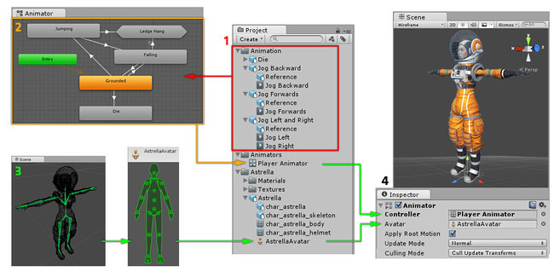
Animation
http://docs.unity3d.com/Manual/AnimationOverview.html

Slide 41
Third Party Applications
Some third party applications are able to import files into Unity
3D Modeling
Blender, Maya, etc
Textures and 2D Art
Gimp or Adobe Photoshop
Sound Effects and Music
Adobe Audition

Slide 42
Artificial Intelligence
Unity does not have stand alone features for AI
The user will have to write their own script for any AI they have in their game.
Unity offers tutorials on how to write AI script.
Can buy other developers scripts from Asset Store.

Slide 43
http://en.wikipedia.org/wiki/Unreal_Engine#/media/File:Unreal_Engine_logo_and_wordmark.png

Slide 44
Unreal Engine
Debut in 1998 with the game Unreal
Created by Epic Games
Unreal Engine 1-3 (1998-2004)
Unreal Development Kit (2009)
Unreal Engine 4 (2012)
Written in C++, C#, UnrealScript, etc.
UnrealScript was removed for UE4

Slide 45
Notable Platforms and games
Platforms
Windows, OS X, and Linux
Xbox One and PS4
Android, Oculus Rift, and Ouya
Games
Street Fighter V
Kingdom Hearts 3
Dead Island 2

Slide 46
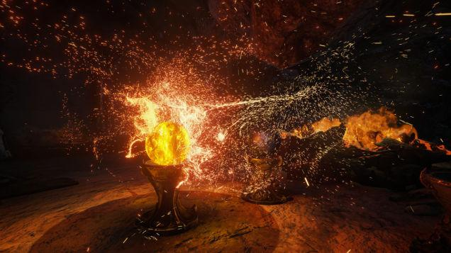
Unique Features of Unreal Engine 4
Debugging during runtime
1st party support
Can make a game by only using UE4
Advanced Particle System
http://kotaku.com/5916859/how-unreal-engine-4-will-change-the-next-games-you-play

Slide 47
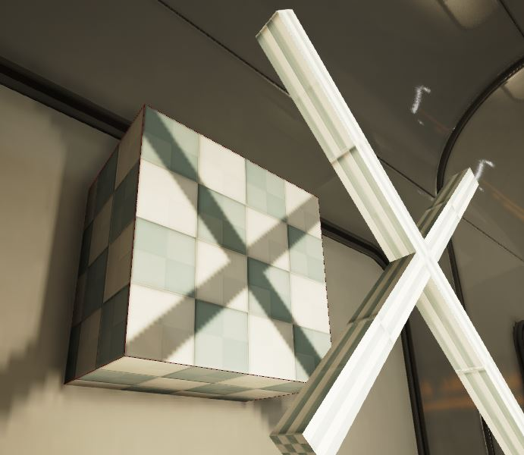
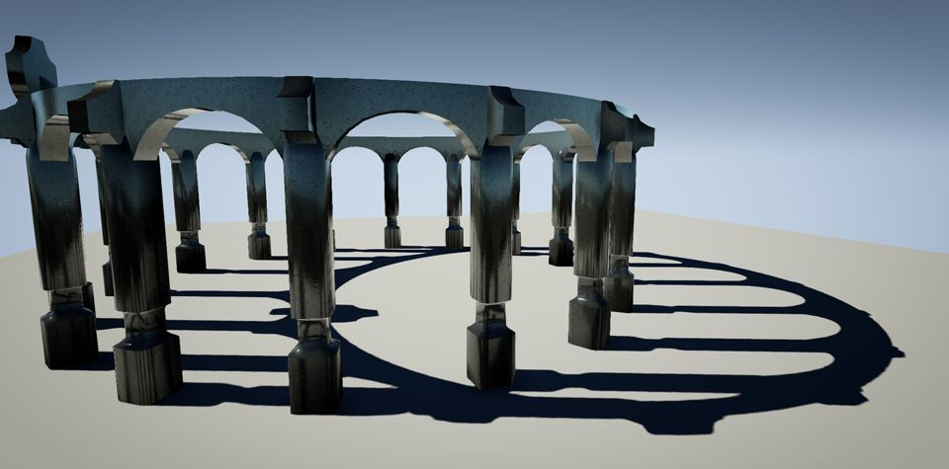
Lighting Paths
Three types of lighting paths
Fully Dynamic (Movable Lights)
Partially Static (Stationary Lights)
Fully Static (Static Lights)
https://docs.unrealengine.com/latest/INT/Engine/Rendering/LightingAndShadows/LightMobility/StaticLights/index.html
https://docs.unrealengine.com/latest/INT/Engine/Rendering/LightingAndShadows/LightMobility/StationaryLights/index.html

Slide 48
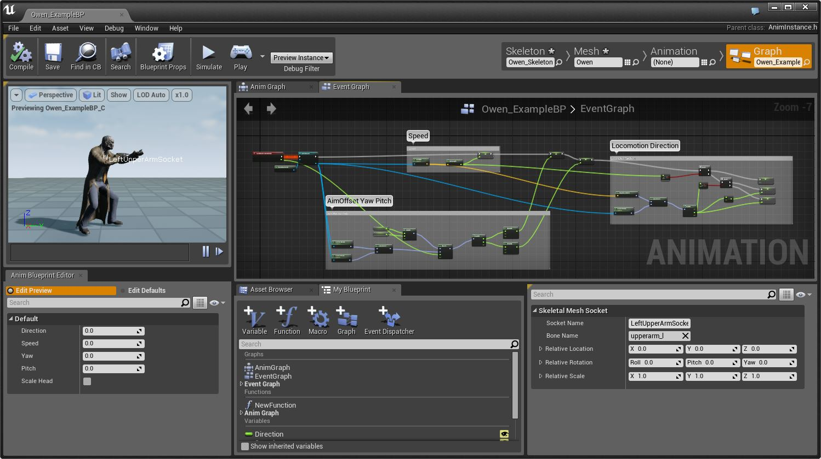
Animations
Persona
Creates and Edits:
Skeletons, Skeletal Meshes, Animation Blueprints, etc.
https://docs.unrealengine.com/latest/INT/Engine/Animation/Persona/index.html

Slide 49
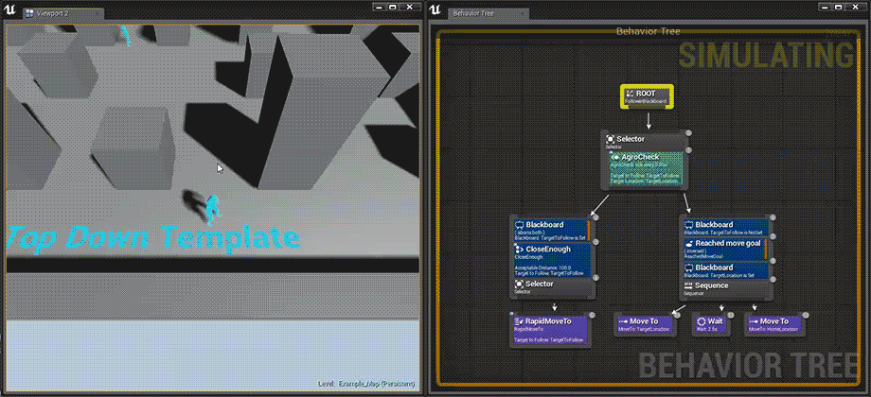
Artificial Intelligence
https://docs.unrealengine.com/latest/INT/Engine/AI/BehaviorTrees/QuickStart/index.html

Slide 50
Difficulty And Mastery Curves

Slide 51
What is it?
A Difficulty Curve is an abstract representation of how a game’s difficulty changes over time.
Level of difficulty
How the difficulty changes
Includes all aspects of a game.
A Mastery Curve is a representation of the ability of a player as they learn how to play a game
Varies based on player

Slide 52
Challenge Curve
A Challenge Curve is the composition of the difficulty curve and the mastery curve.
The conceptual ‘Difference’ between difficulty and mastery
Challenge is what keeps the player playing our game

Slide 53
As Game Designers, a key goal is to ensure that the target audience wants to play the game. In this context, this means giving the player an appropriate challenge.

Slide 54
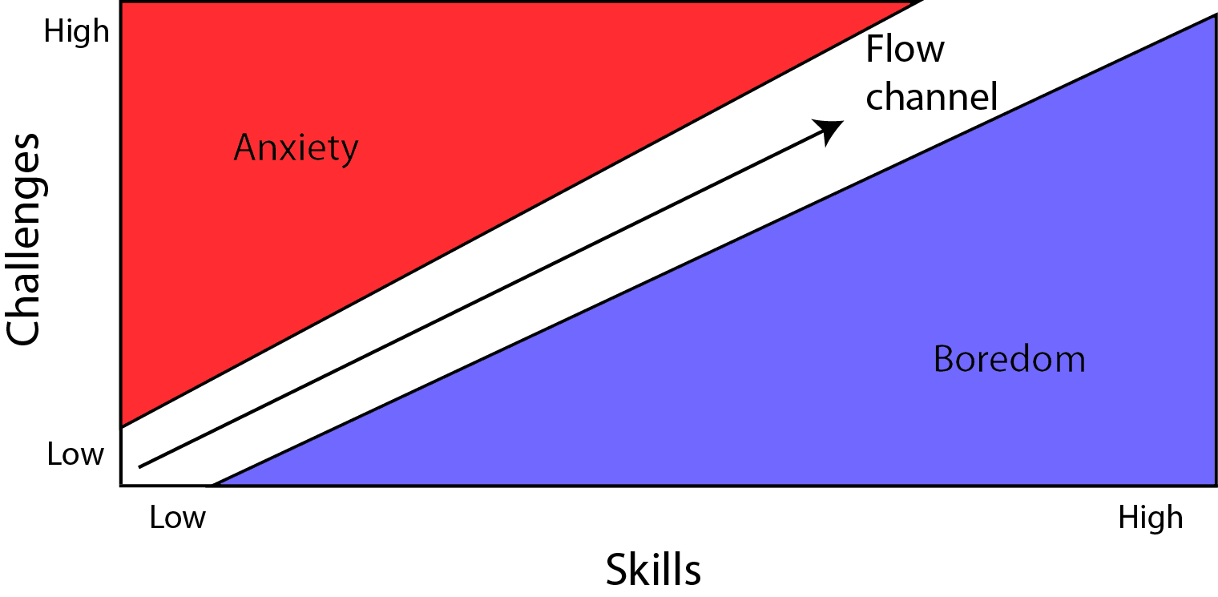
What makes people stop playing games?
Anxiety
-Occurs when the challenges of a game greatly exceeds the mastery of the player
Boredom
-Occurs when a game does not present a sufficient challenge to the player

Slide 55
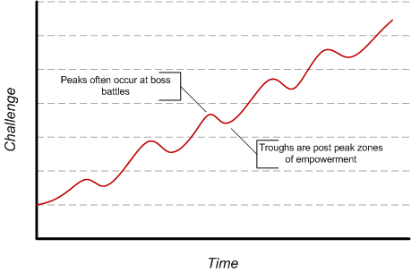
The “Ideal” Challenge Curve
Key Ideas:
-Increases are not monotonic
-People tend to enjoy cycles of tension (steep portions) and resolution (downward slopes)
-Keeps players in a Flow State

Slide 56
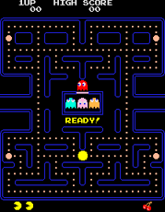
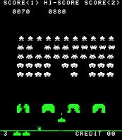
The “Arcade Era”
-Limited Resources
-Quarter driven gameplay
-Sets precedent for future game design
Space Invaders (1978)
Pac-Man (1980)

Slide 57
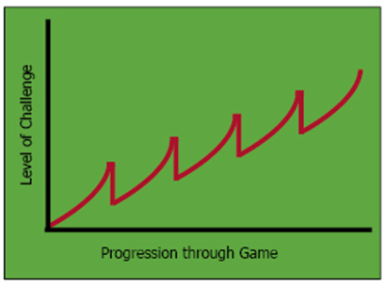
Example: Space Invaders

Slide 58
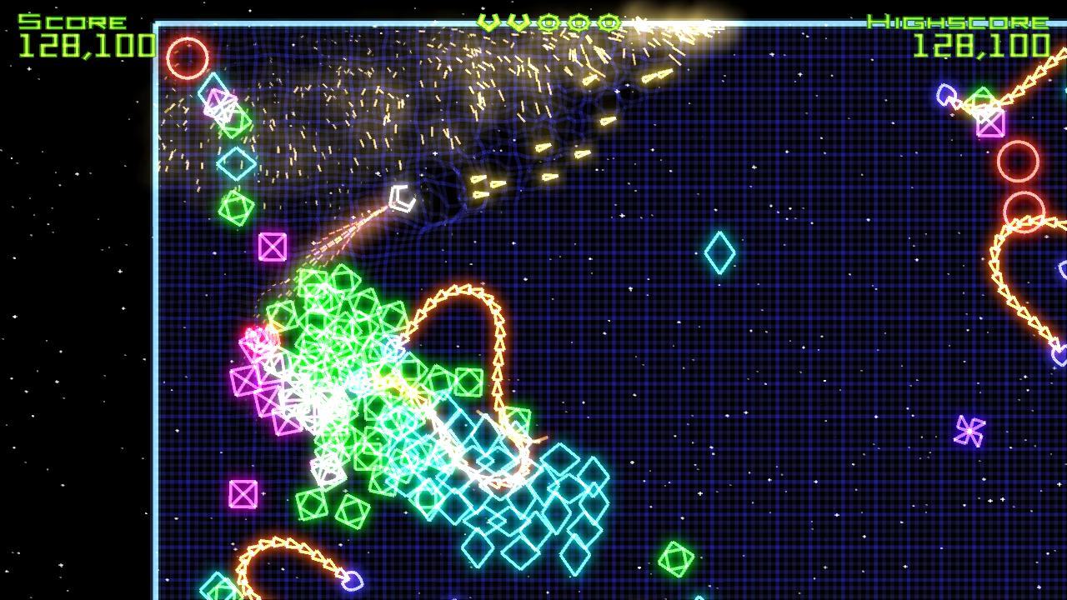
First key axis of difficulty
Axis of Obstacles
Changes the game quantitatively
Number of enemy units in a level
Enemy Speed
etc.
Simple to implement
More deterministic
Still very much in use in modern games
Controls the difficulty curve of a game
Geometry Wars (2003)

Slide 59
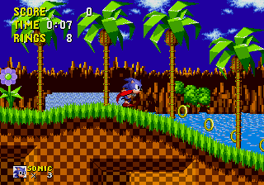
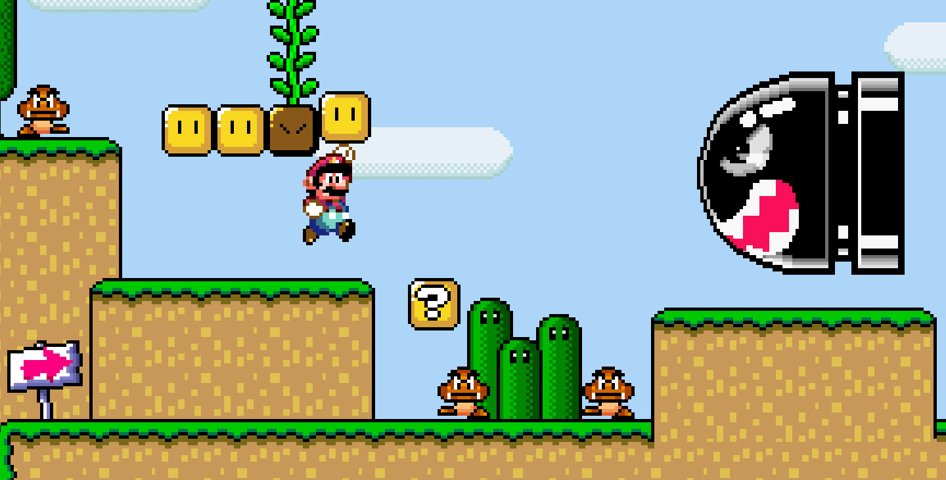
The “Composite Era”
-Consoles begin to become popular
-Games designed as composites of genres
-Much more variability in game and level design
Sonic The Hedgehog (1991)
Super Mario World (1990)

Slide 60
Second key axis of difficulty
Axis of Abilities
Changes the game qualitatively
Powerups
Level Designs
Characters
etc.
More complex to implement
Creativity required
More Dynamic
Much more diverse than Axis of Obstacles
Controls the Mastery Curve
New Super Mario Bros. (2006)

Slide 61
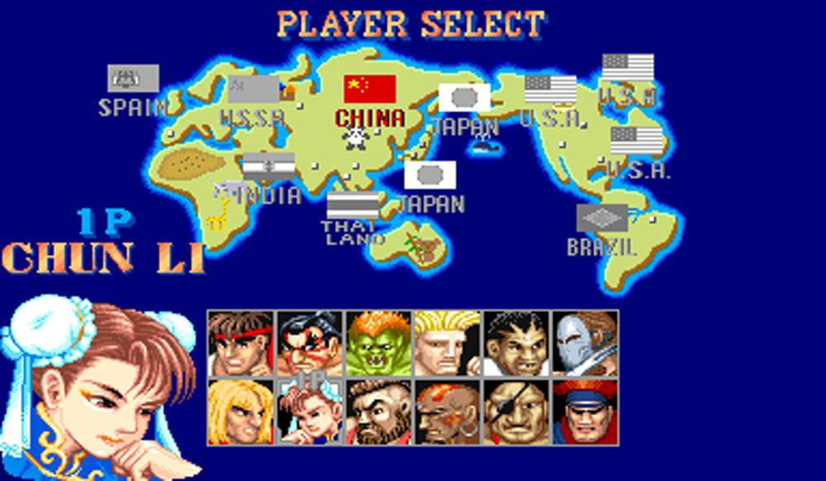
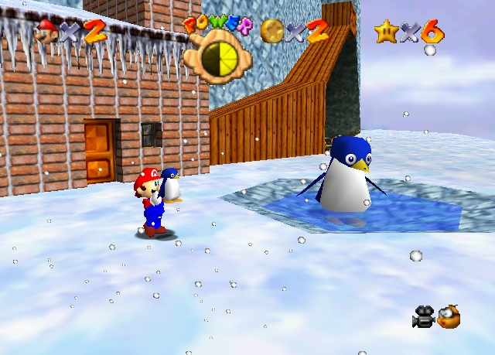
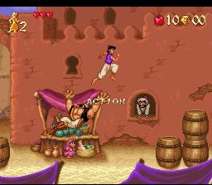
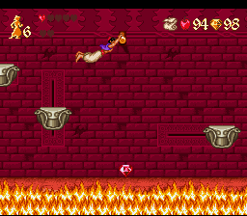
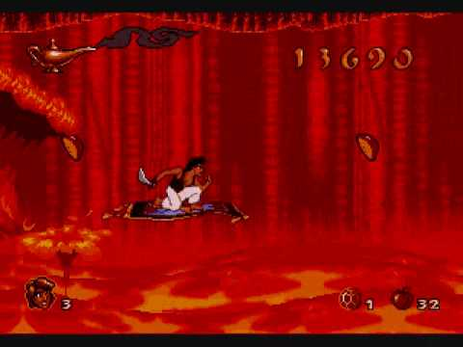
More Examples...
Street Fighter II (1991)
Super Mario 64 (1996)
Aladdin (1993)

Slide 62
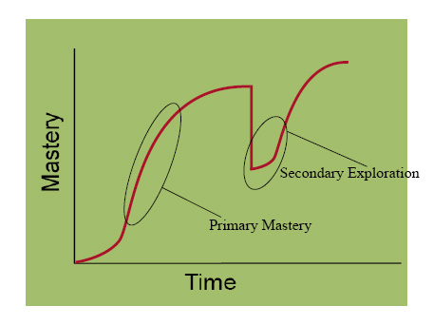
General Mastery curve for Composite Games

Slide 63
Other types of Challenge Curves
Darwinian Challenge Curves
Throw the player in headfirst. Only the strongest survive!
Extremely brutal
Null Challenge Curves
Assume the player has most of the skills they need, allow them to play as they wish.
Extremely forgiving
‘Open’ Challenge Curves
Provide a relatively low challenge with the option for the player to explore more difficult routes
High degree of freedom

Slide 64
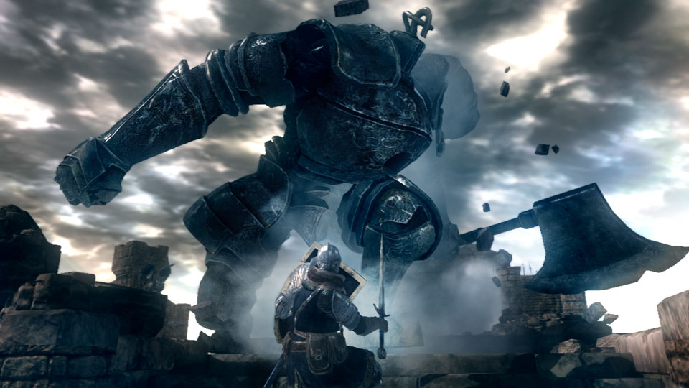
Darwinian games ex. Dark Souls… Good Luck.

Slide 65
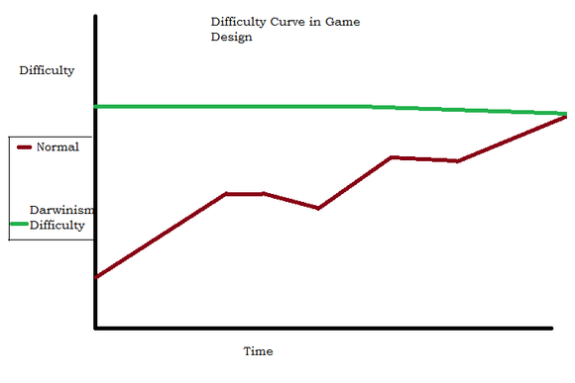
Darwinian Difficulty
-Looks like the Green
Line
-Game must be
predominantly skill based
-Game must still include
gameplay growth. Boss variety, player upgrades,
etc.
-Challenge curve actually decreases as players improve
-Relies on Player having great sense of self
satisfaction upon beating levels.

Slide 66
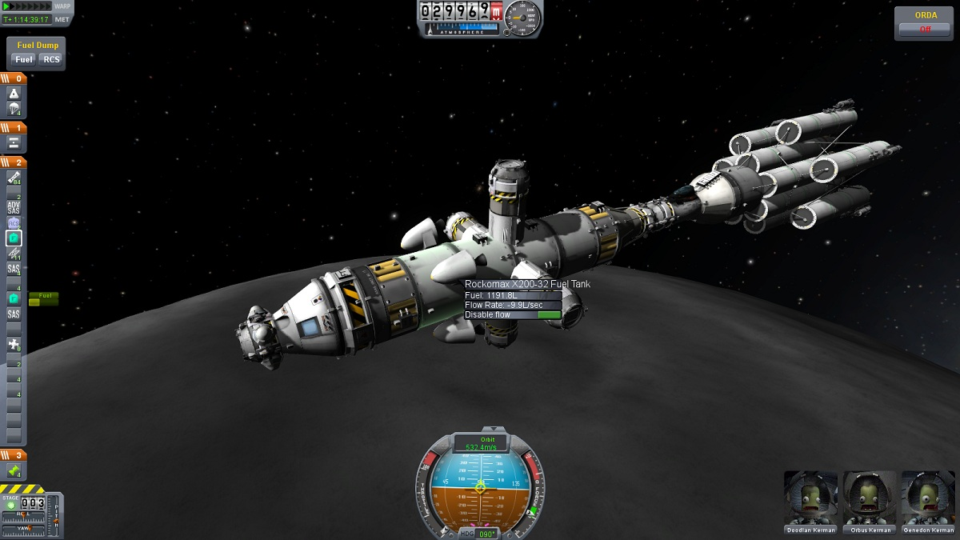
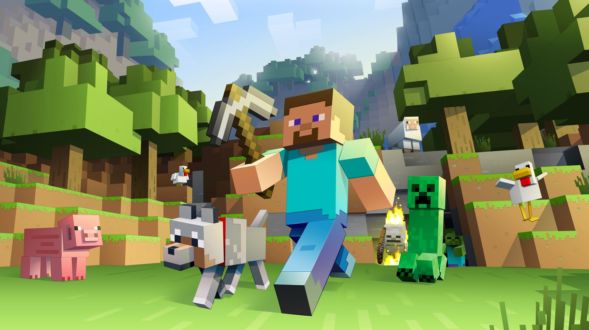
Games with null difficulty curves
Farmville (2009)
Nintendogs (2005)
Kerbal Space Program (2011)
Minecraft (2009)

Slide 67
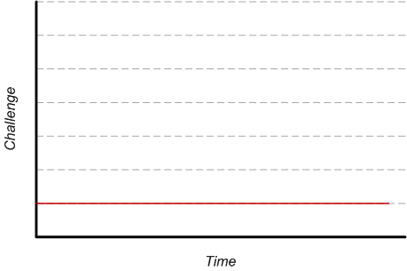
Null Challenge Curves
-Challenge is non-zero
-Challenge lies in meta
aspects of the game
such as playing frequently
and self imposed goals
-At no point is progress barred by the game.
-Enjoyment of the game is largely separated from
challenge in this instance
-Ensure players can accomplish tasks regularly
enough to maintain interest

Slide 68
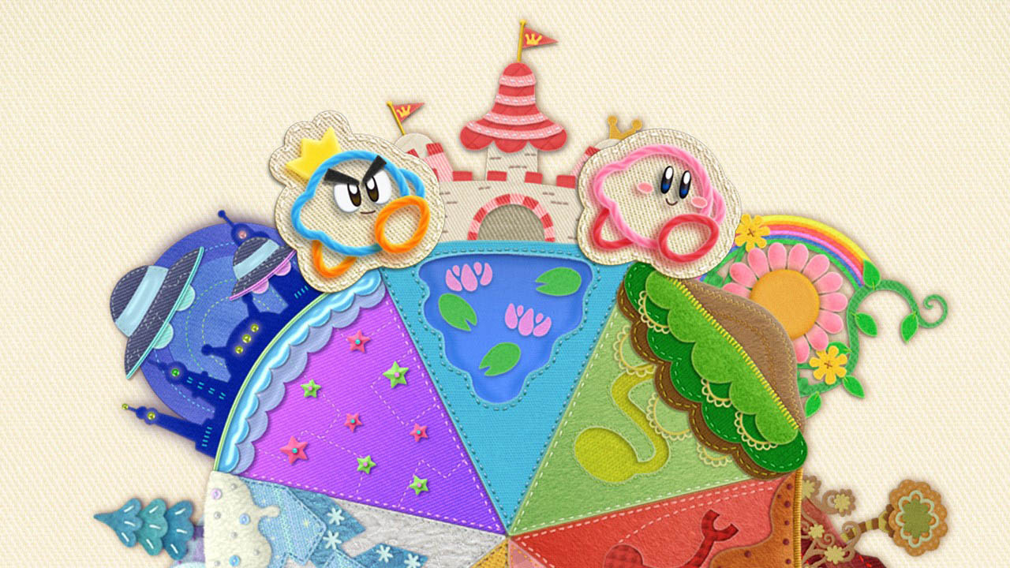
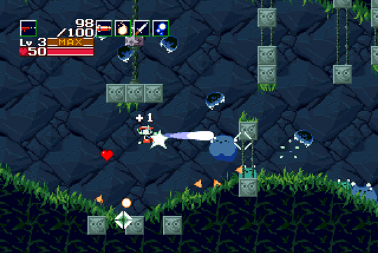
Examples of open challenge curves
Kriby’s Epic Yarn (2010)
Cave Story (2004)

Slide 69
Open Challenge Curves
-Challenge lies in a range
of possibilities
-Sometimes finite amount
of possibilities
-Generally gives the players options as to how to play the game
-Common implementation of this is “100%” mode
-Less common is a game with multiple endings
based upon players decisions during the game

Slide 70
How should difficulty be implemented?

Slide 71
Ways of Increasing Difficulty
Altering the interface
Take away some of the HUD
Minimap
Attribute indicators
Force the player to rely on their reflexes or knowledge of the situation
Can be frustrating if a game is balanced around the removed system

Slide 72
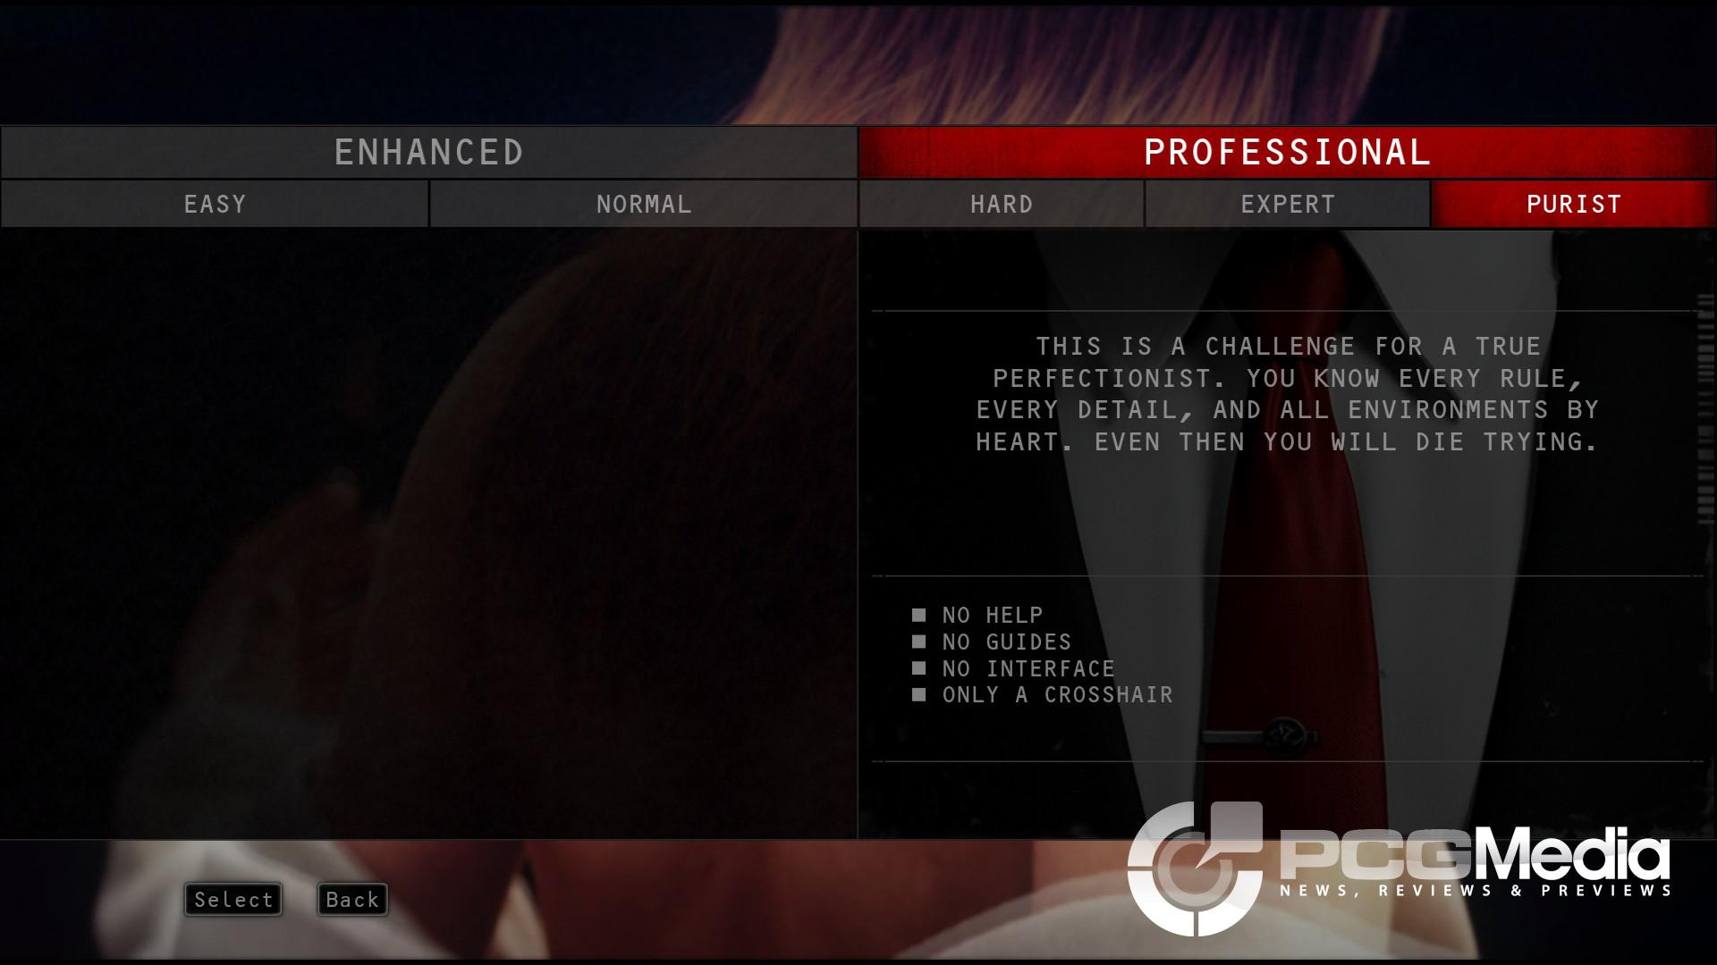
Example of Altering the Interface
Hitman: Absolution (2008)

Slide 73
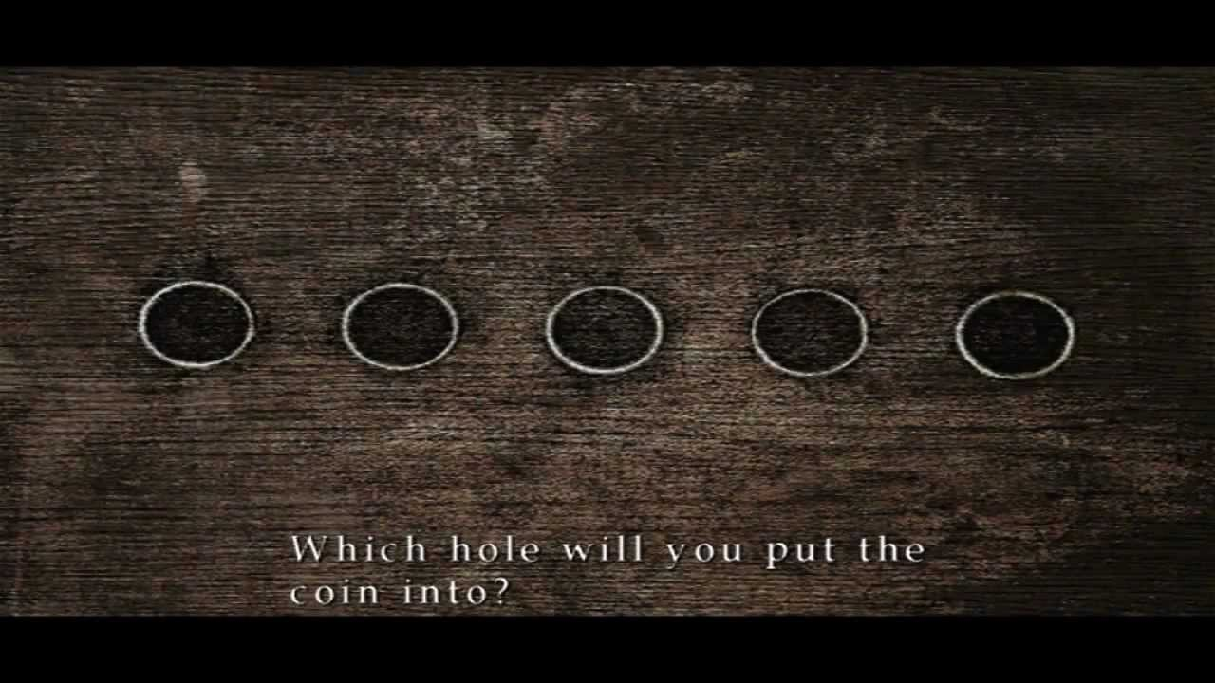
Ways of Increasing Difficulty
Changing the design of the game
Puzzles, levels, etc
Very satisfying to the player looking for a challenge
Much more work than other ways
Silent Hill 2 (2001)

Slide 74
Easy
Hardest
“To the right is the lady.
To the left is the old one.
In the center crawls the other.
Now just two spaces remain,
But fear not for now,
The puzzle is done.
The puzzle is Done.”
"Like coins in the hazy
aether tossed
Our souls must by
their sinful weight
Descent to earth
with lightness lost
To "right" the sins
that they hath laid
When thrice in falling they intone
Then Happiness shall be they own
The first note be not by
the Horned One rung
Though it be there that
all sins be sprung
The Bringer of Life and
the Bringer of Shame
The sins of the latter be
ever more tame
Though coming
in the Aged One's wake
The Formless One's soul
in fear doth quake
The Needless One, silent,
with hungers all sated
Is least then in sin
with his lusts all abated
For the gravest of sinners
His place be appointed
And if he be lucky
May his soul be anointed

Slide 75
Ways of Increasing Difficulty
Increasing (or decreasing) the difficulty of a game based on the skill of the player
Tries to ensure that the player will never feel frustrated or bored by the game by keeping the challenge “at the right level”
Difficult to get right

Slide 76
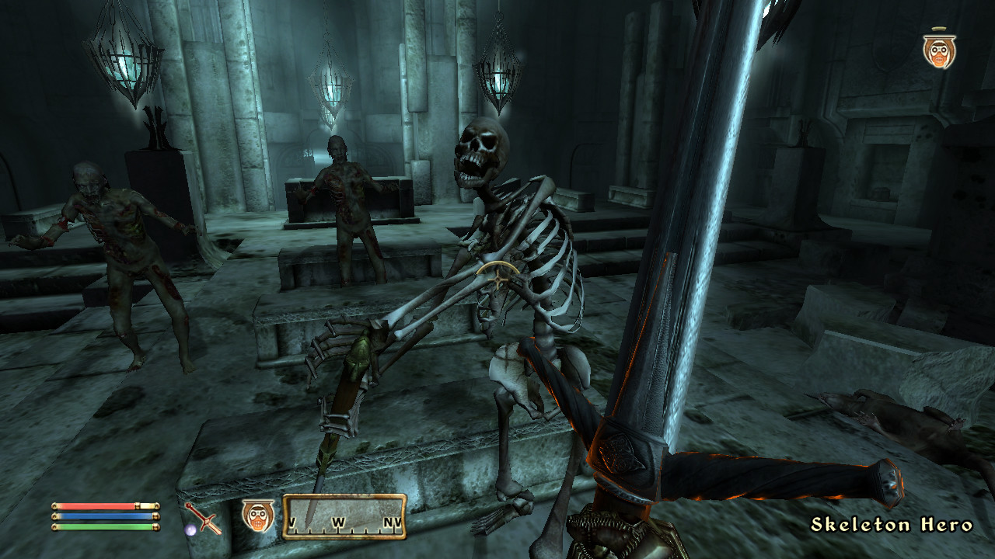
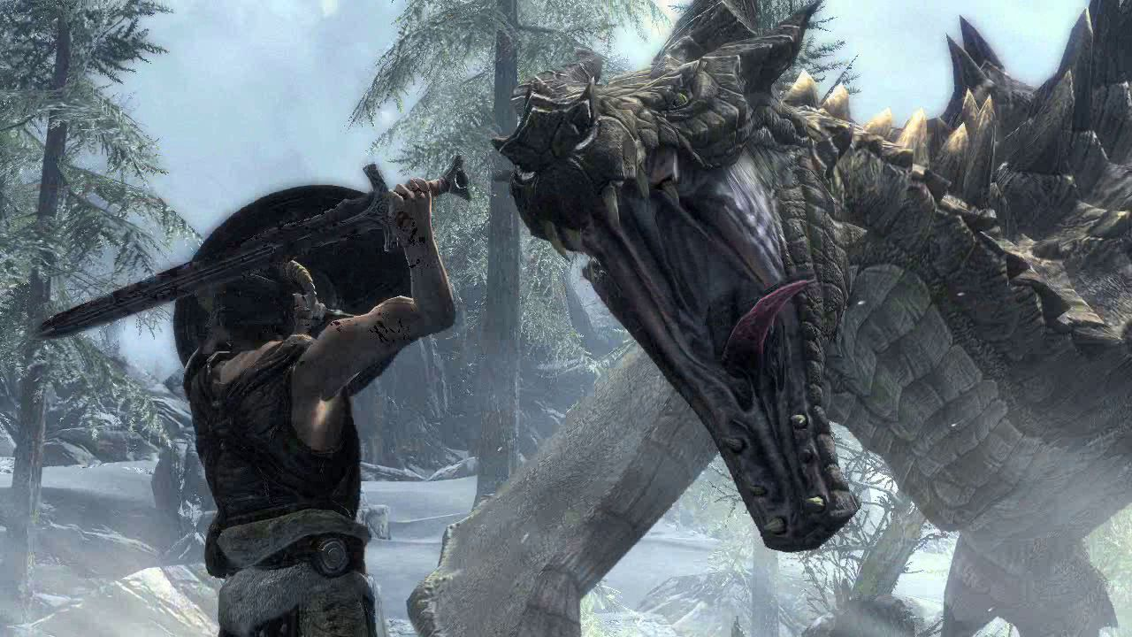
Examples of Level Scaling
The Elder Scrolls IV: Oblivion (2006)
The Elder Scrolls V: Skyrim (2011)

Slide 77
Feedback is Crucial
No matter what way difficulty is implemented, make sure to give the player plenty of feedback when they fail
Tips
Killcams
AI Patterns
“A player must always feel like the failure of a challenge is entirely his own responsibility, and not a fault of a poorly designed product”
Daniel Boutros, Gamasutra

Slide 78
Questions?

Slide 79
References
Screenshots of the games:
http://www.popularmechanics.com/culture/gaming/g134/the-100-greatest-video-games-of-all-time/?slide=6
Challenge vs. Skills:
http://www.gamasutra.com/blogs/ToniSala/20131208/206535/Game_Design_Theory_Applied_The_Flow_Channel.php
The “Ideal” Challenge Curve Concept:
http://www.academia.edu/624611/Measuring_the_level_of_difficulty_in_single_player_video_games
The “Ideal” Challenge Curve Image:
http://www.gamasutra.com/blogs/JonBrown/20100922/88111/Difficulty_Curves_Start_At_Their_Peak.php
Null Challenge Curves:
http://www.gamasutra.com/blogs/JonBrown/20100922/88111/Difficulty_Curves_Start_At_Their_Peak.php
Space Invader Example:
http://thegamedesignforum.com/features/GDH_1.html

Slide 80
References
Introduction to Game Design, Prototyping, and Development:
http://book.prototools.net/
Iterative Design Images:
https://gamedesignconcepts.wordpress.com/2009/07/02/level-2-game-design-iteration-and-rapid-prototyping/
Slide Template:
http://www.slidescarnival.com/nathaniel-free-presentation-template/301
Others:
http://24.media.tumblr.com/7e1f3179fcffb2f6b1e4b2adc2369ba3/tumblr_mmz01nhzMZ1r6w88do2_1280.jpg
http://www.technapex.com/wp-content/uploads/2012/10/GameControllers1.jpg
http://www.gamepur.com/files/images/2011/crysis-2-multiplayer-screenshots.jpg
The references of the game engines section are attached under each image

